Slide 1


UBS Hackathon 2025
Financial Risk Analyzer Agent
AI-Powered Risk Intelligence for UBS
Transforming reactive risk management into proactive risk intelligence
The Problem
Financial institutions struggle with fragmented risk assessment, delayed insights, and human bias in analyzing market, credit, liquidity, operational, and regulatory risks.
Team FinRisk AI
1

Slide 2

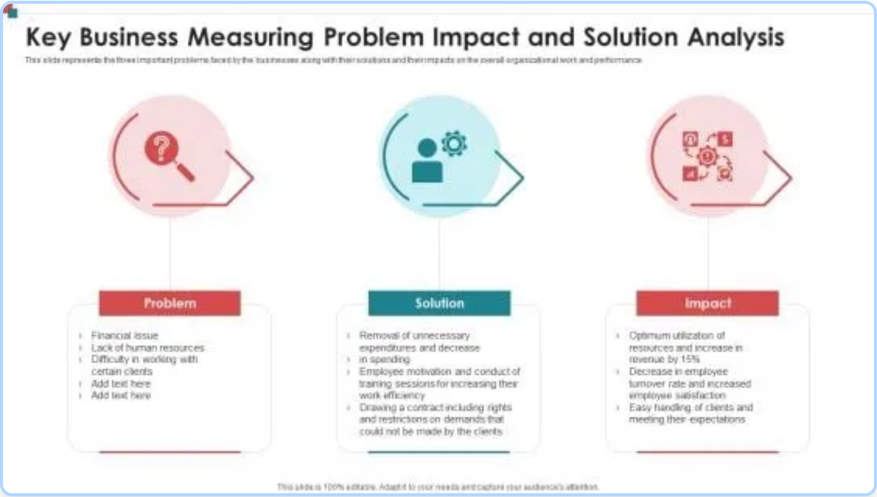
The Business Problem & Our Solution
Business Problem
Financial institutions face critical challenges in risk management:
Siloed risk assessment processes across different departments
Delayed insights due to manual data collection and analysis
Inconsistent risk evaluation methodologies
Human bias in interpreting complex market signals
Inability to process vast amounts of real-time data
Regulatory compliance gaps due to oversight
Our Solution
The Financial Risk Analyzer Agent addresses these challenges by:
Unifying risk assessment through a multi-agent AI system
Providing real-time monitoring and analysis of risk factors
Implementing consistent, quantifiable risk scoring methodology
Eliminating human bias with data-driven analysis
Leveraging multiple data sources through specialized APIs
Generating comprehensive risk reports with actionable insights
Team FinRisk AI
2

Slide 3

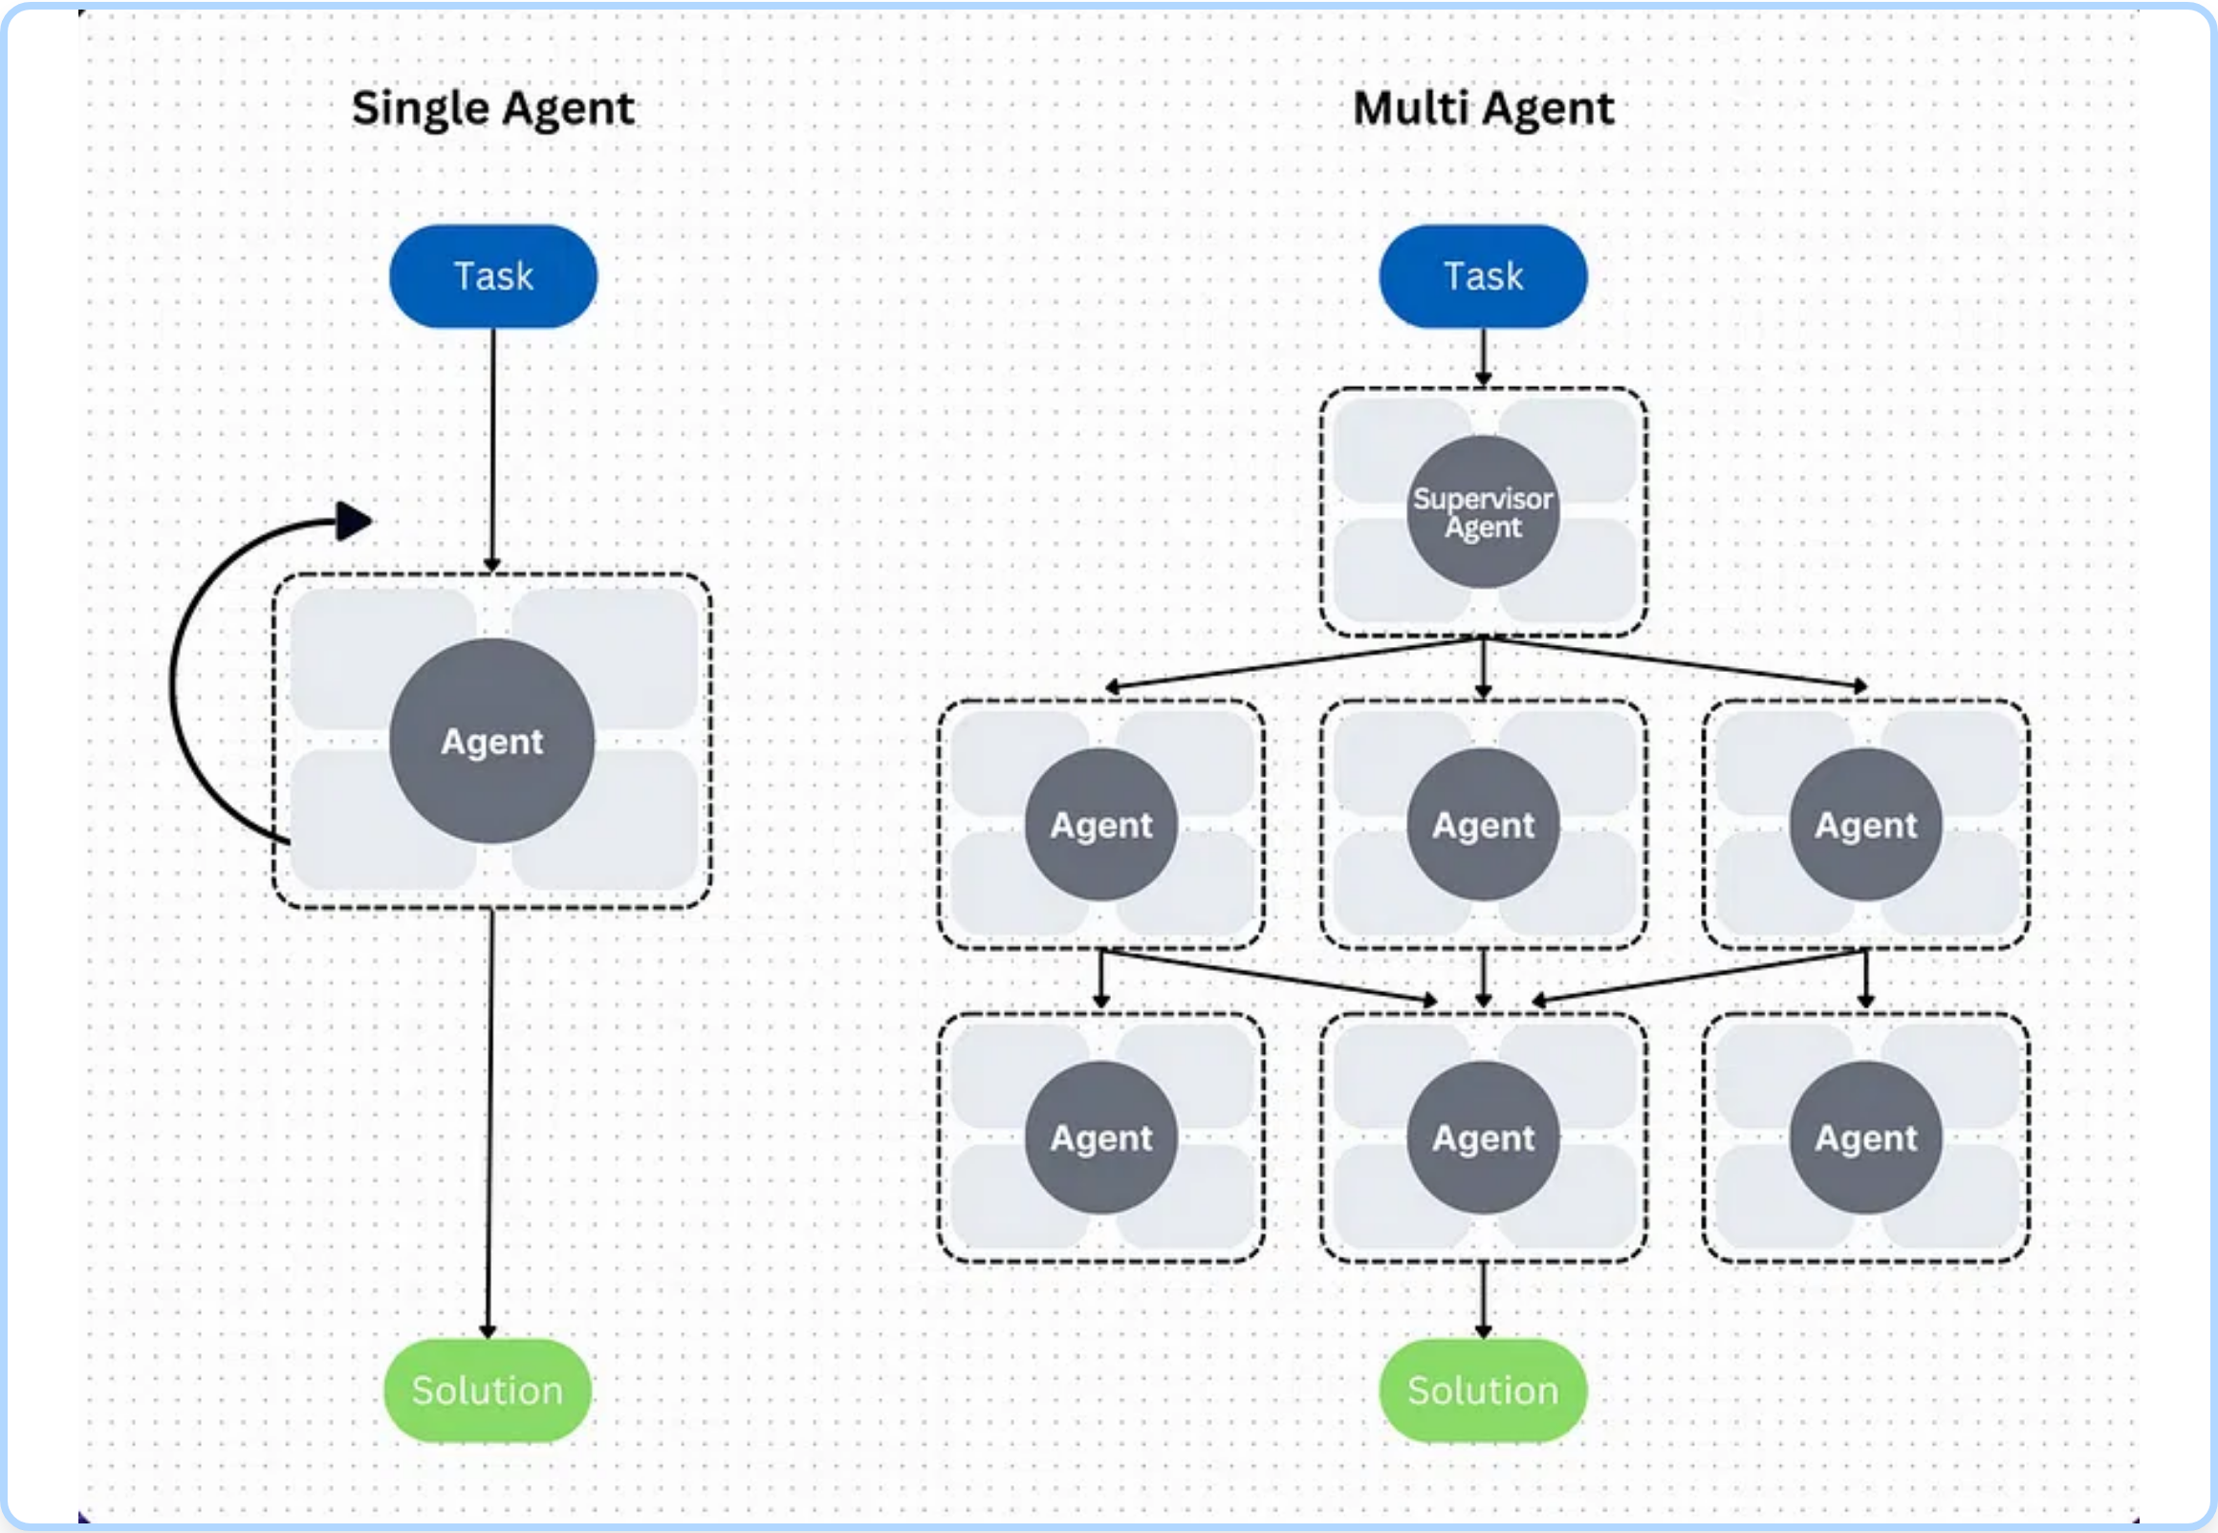




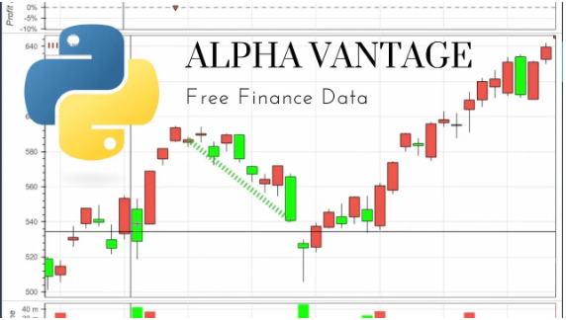

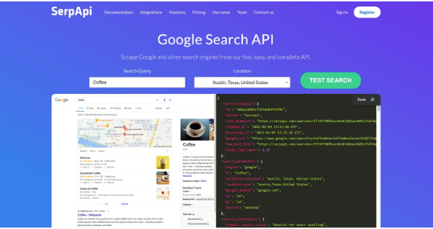


Under the Hood: Architecture & Technology
Technology Stack
Python
LangGraph
LangChain
LLM
Data APIs
Alpha Vantage API
FRED API
Real-time and historical stock data, forex, and cryptocurrencies
Economic indicators and financial data from Federal Reserve
SerpAPI
Tavily API
Real-time search data for market sentiment analysis
Specialized search for financial news and reports
Key Components
Orchestration React Agent coordinates all specialized agents
Five specialized React Agents for each risk category
Team FinRisk AI
3

Slide 4

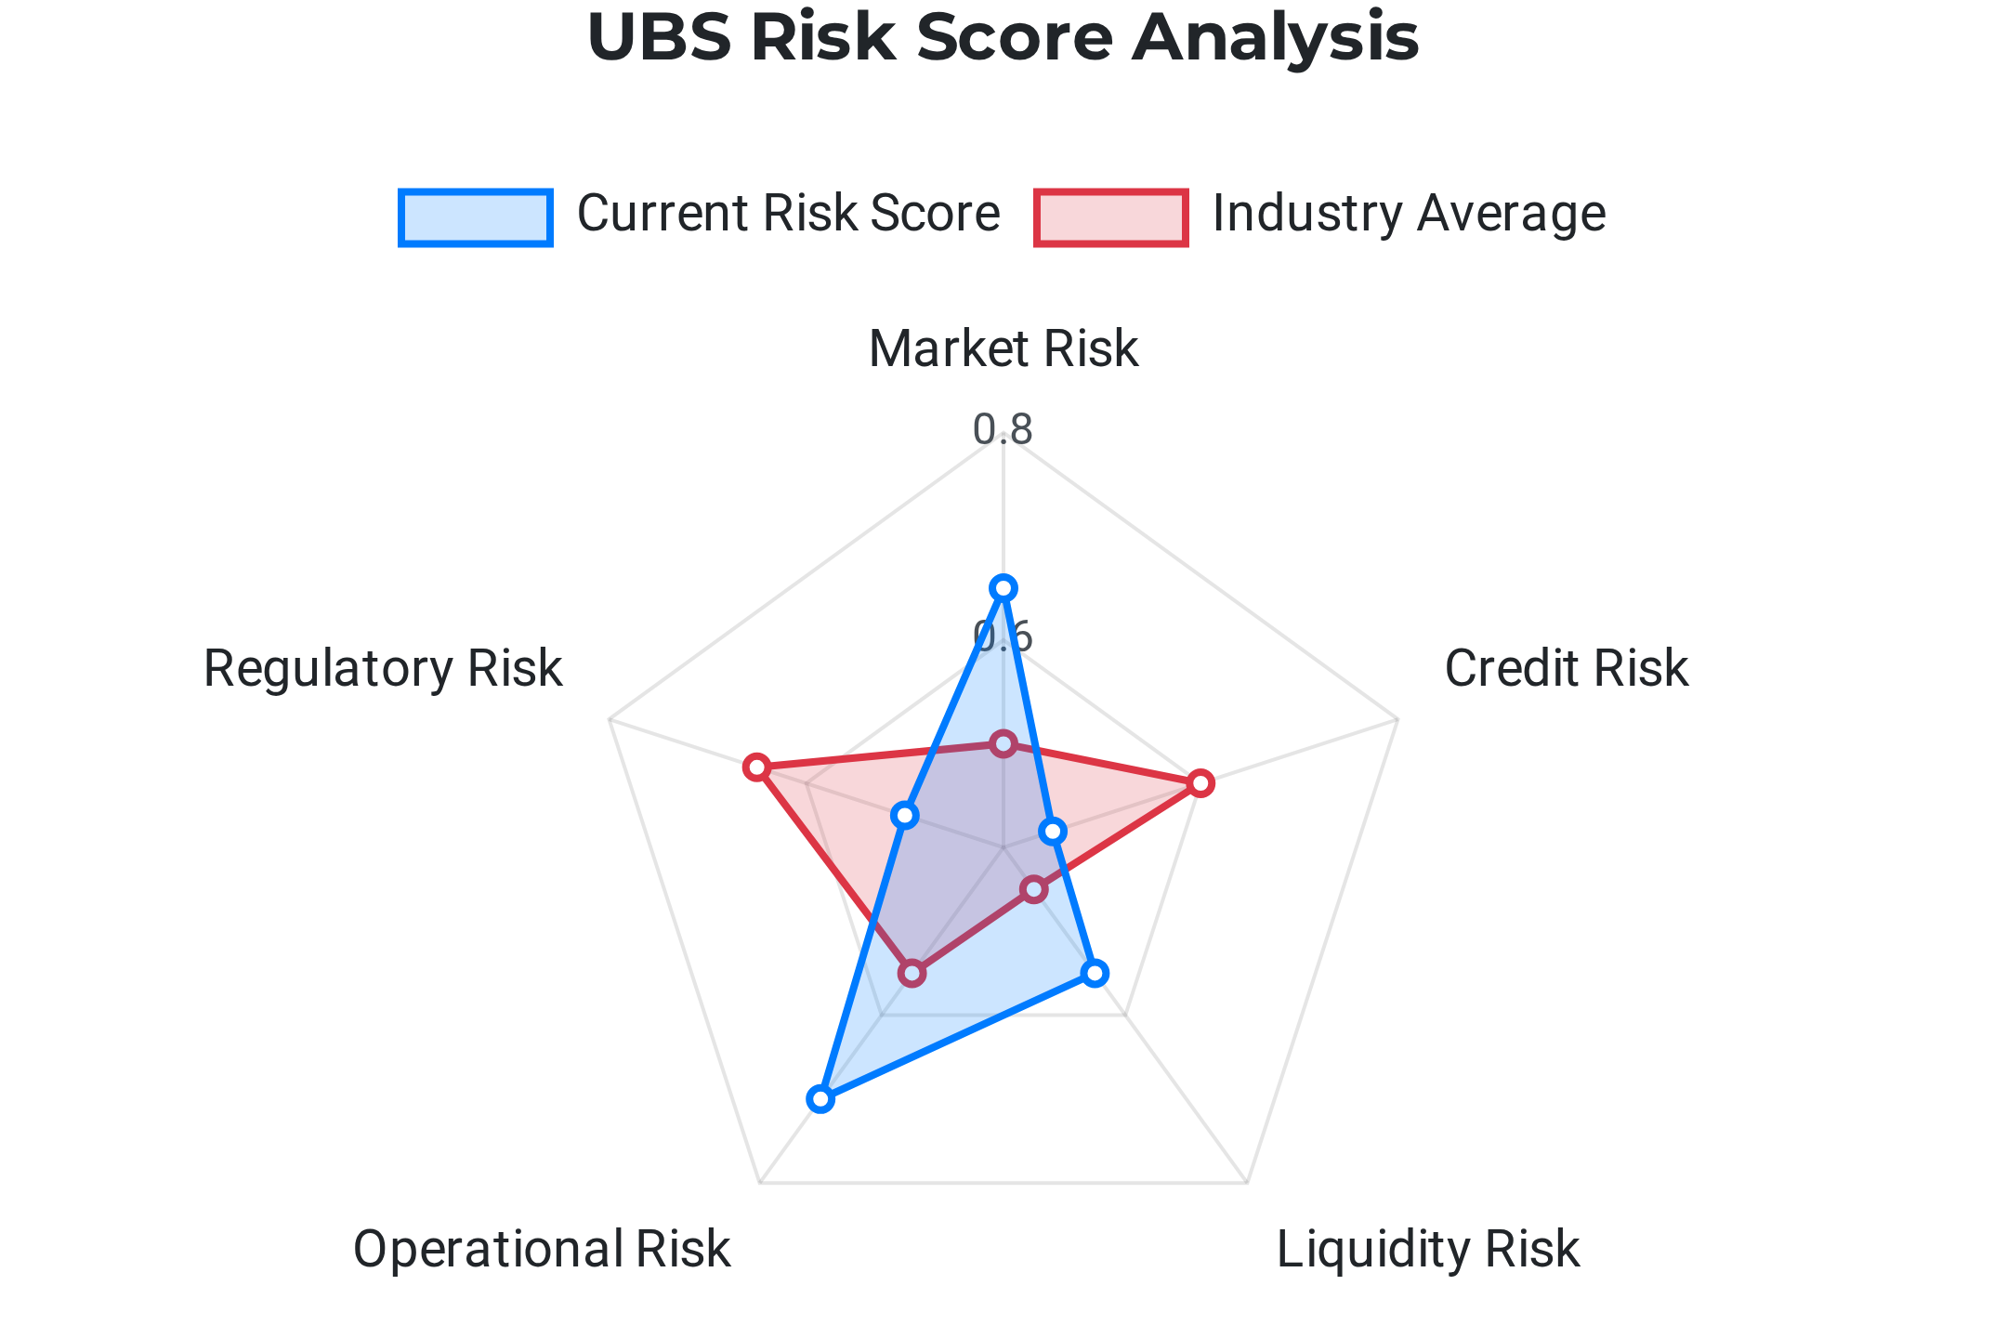



The Impact: Quantifiable Risk Scores for UBS
Risk Scoring Methodology
Identify key parameters for each risk category
Monitor top 5 keywords with maximum impact
Assign sentiment scores (0-1) based on impact severity
Aggregate into composite score per risk category
Value for UBS
Enables data-driven decision making, early risk detection, enhanced regulatory compliance, and competitive advantage through AI-powered risk intelligence.
Team FinRisk AI
4

Slide 5


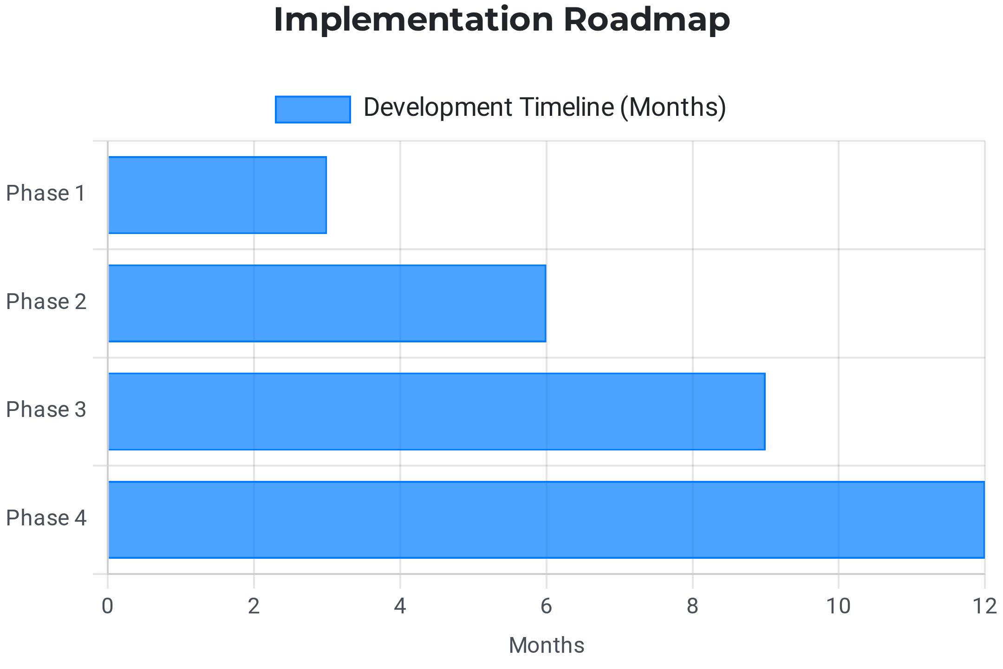




Future Vision: Scaling and Evolution
Roadmap for Enhancement
Real-time data integration with market feeds
Advanced predictive modeling for trend forecasting
Customizable risk parameters and thresholds
Interactive dashboards for risk monitoring
Expansion to global markets and currencies
Long-term Vision
Transform UBS into the industry leader in AI-powered risk intelligence, setting new standards for proactive financial risk management.
Team FinRisk AI
5

Slide 6






Call to Action: Join Us in Revolutionizing Finance
Why Choose Our Solution?
Comprehensive risk assessment across all financial domains
Data-driven decision making with quantifiable metrics
Early warning system for emerging financial risks
Reduced human bias through AI-powered analysis
Meet Team FinRisk AI
Competitive advantage in risk intelligence
Alex Chen
Sarah Johnson
Michael Lee
AI Architect
Financial Analyst
Data Scientist
Ready to Transform Risk Management?
contact@finrisk.ai
Partner with us to implement the Financial Risk Analyzer Agent and lead the industry in AI-powered risk intelligence.
UBS Hackathon 2025
6

